Slide 1
Linear Regression
Assumptions of linear regression
and interpreting R squared values
ISSU2028 Data Science Dr Phil Lewis

Slide 2
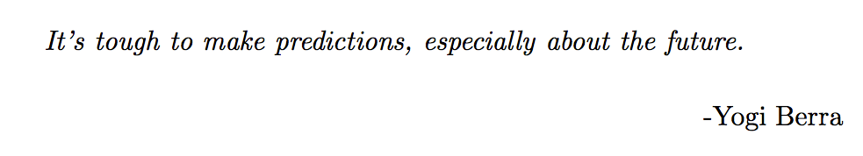
Assumptions of linear regression
Some notes on interpreting R squared values and on the LINE assumptions that must apply in order for the results and predictions of linear regression to hold.
ISSU2028 Data Science Dr Phil Lewis

Slide 3
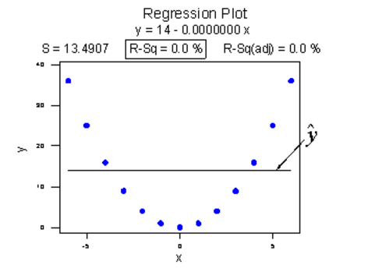
Interpreting R²
R² = 0 does not mean the input and outputs are uncorrelated.
ISSU2028 Data Science Dr Phil Lewis

Slide 4
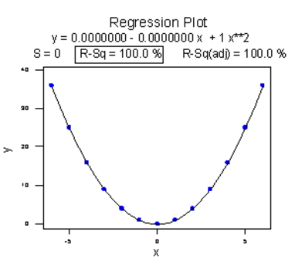
Interpreting R²
R² = 0 does not mean the input and outputs are uncorrelated.
Here there is a good fit to a non-linear function.
ISSU2028 Data Science Dr Phil Lewis

Slide 5
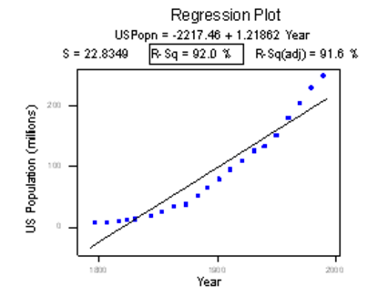
Interpreting R²
R² high does not mean linear fit is best
Here a curved fit would give a higher R².
ISSU2028 Data Science Dr Phil Lewis

Slide 6
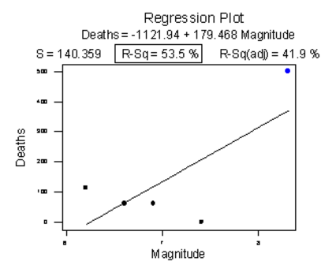
Interpreting R²
Outliers can have a big effect of the fit
Test and refit removing outliers.
If variables do have
linear relationship then it should not change fit by large amount.
ISSU2028 Data Science Dr Phil Lewis

Slide 7
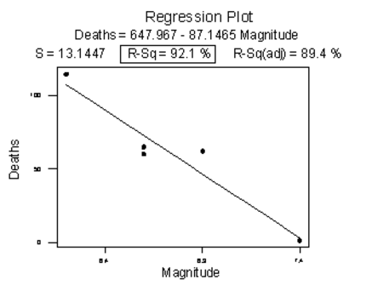
Interpreting R²
Outliers can have a big effect of the fit
Test and refit removing outliers.
Here we get a different (and better fit) after removing outliers.
ISSU2028 Data Science Dr Phil Lewis

Slide 8
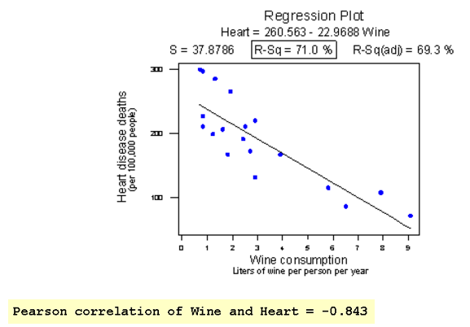
Interpreting R²
Correlation does not mean causation.
e.g. other effects not included in the model may responsible for the correlation observed
ISSU2028 Data Science Dr Phil Lewis

Slide 9
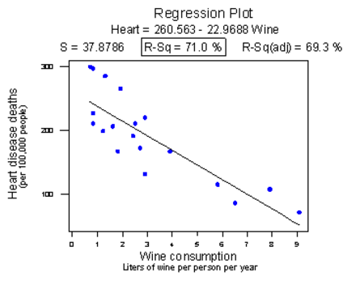
Interpreting R²
If we aggregate data e.g. each sample is for a population we
can find correlations which may not be practically significant when making predictions for individuals.
e.g. chance of heart disease for individual may be:
9.236% if you drink 2 glasses of wine
vs 9.237% if you drink 4 glasses of wine
ISSU2028 Data Science Dr Phil Lewis

Slide 10
Assumptions when applying linear regression
Does the relationship and fit output let us assume the following?
L
The input and output variables follow a linear relationship.
I
Each pair of data points (yi, xi) are independent – ie uncorrelated
N
The residuals at all variable of x follow a normal distribution around the fitted line of regression
E
The residuals at all variable of x have equal variance
If not our… predictions for the fit coefficients and predictions for y when provided with x_{i}
tests of model significance
may not be valid
ISSU2028 Data Science Dr Phil Lewis

Slide 11
Assumptions when applying linear regression
Comments on validity when assumptions are violated
More problematic
I
If our sampled measurements (yi, xi) are correlated
(with respect to each other, or the fit)
Tests and intervals results sensitive to minor departures!!!
E
The size of the residuals are dependent on the x value.
Tests and intervals results sensitive to moderate departures!!
N
The residuals at all variable of x follow a non-normal distribution around the fitted line of regression
Tests and Intervals for fit parameters fairly robust to this.
Prediction intervals for new data are sensitive to this.
Less problematic
Note there is scope to make adjustments to fit and results
To account for some of these effects.
ISSU2028 Data Science Dr Phil Lewis

Slide 12
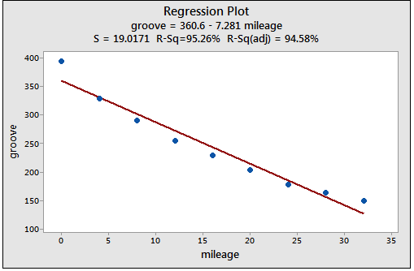
Viewing problems by examining residuals
Viewing problems by plotting the residuals
Residuals are not independent after fitting – either transform variables so relationship
appears linear or use a polynomial e.g. quadratic regression.
ISSU2028 Data Science Dr Phil Lewis

Slide 13
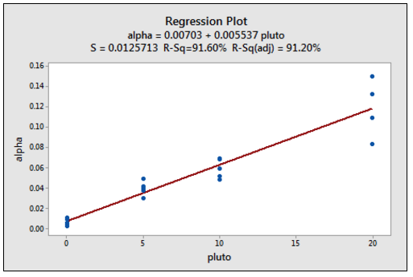
Viewing problems by examining residuals
Viewing problems by plotting the residuals
Size of residuals increases with X - heteroskedasity
We can test and correct our fit estimations for this (see seminar 6)
ISSU2028 Data Science Dr Phil Lewis

Slide 14
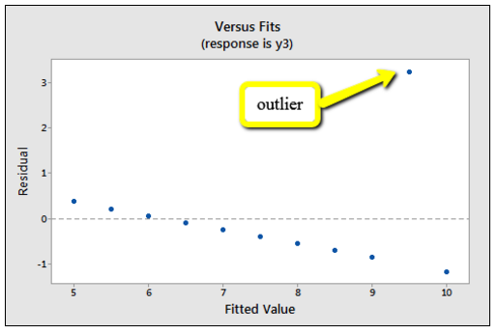
Viewing problems by examining residuals
Viewing problems by plotting the residuals
If an outlier is present it may pull the fitted line away disproportionately.
The other residuals then will seem to follow a linear relationship.
-> remove the outlier and refit!
ISSU2028 Data Science Dr Phil Lewis

Slide 15
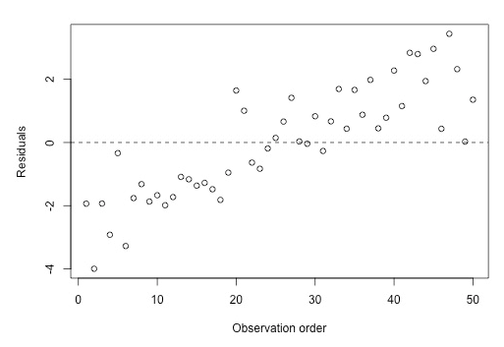
Viewing problems by examining residuals
Viewing problems by plotting the residuals
Sometimes there will be a drift over time. (e.g. if some unaccounted variable gradually changes e.g. we lose an inch of height from the time we wake up to the time we go to bed as our spine compresses. Therefore if we spent all day measuring heights, those measured in the morning would on average be higher!
ISSU2028 Data Science Dr Phil Lewis

Slide 16
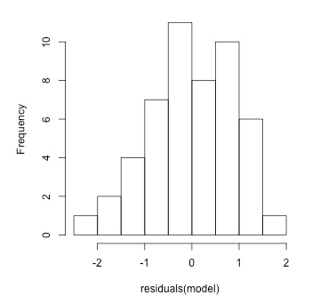
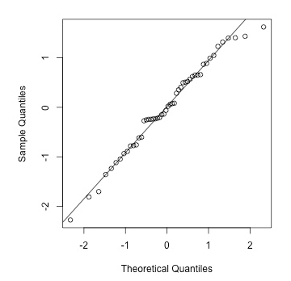
Viewing problems by examining residuals
Viewing problems by plotting the residuals
To inspect whether it is reasonable to assume that the residuals are normally distributed we can plot a histogram or Q-Q (quantile-quantile plot)
A normal distribution will lie on the y=x line on a Q-Q plot. Note in extremes of the plot that correspond to the tails of the distb we often see deviations as only a few values are in the extremes.
ISSU2028 Data Science Dr Phil Lewis

Slide 17
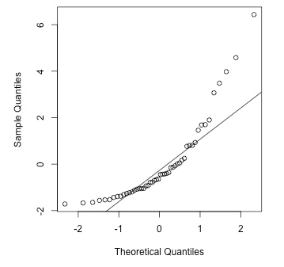
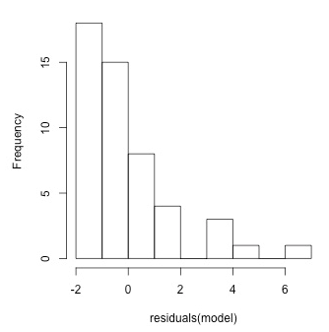
Viewing problems by examining residuals
Viewing problems by plotting the residuals
Here the distribution of residual is skewed (large tail on RHS)
The result is that the Q-Q plot deviates from y=x line.
ISSU2028 Data Science Dr Phil Lewis

Slide 18
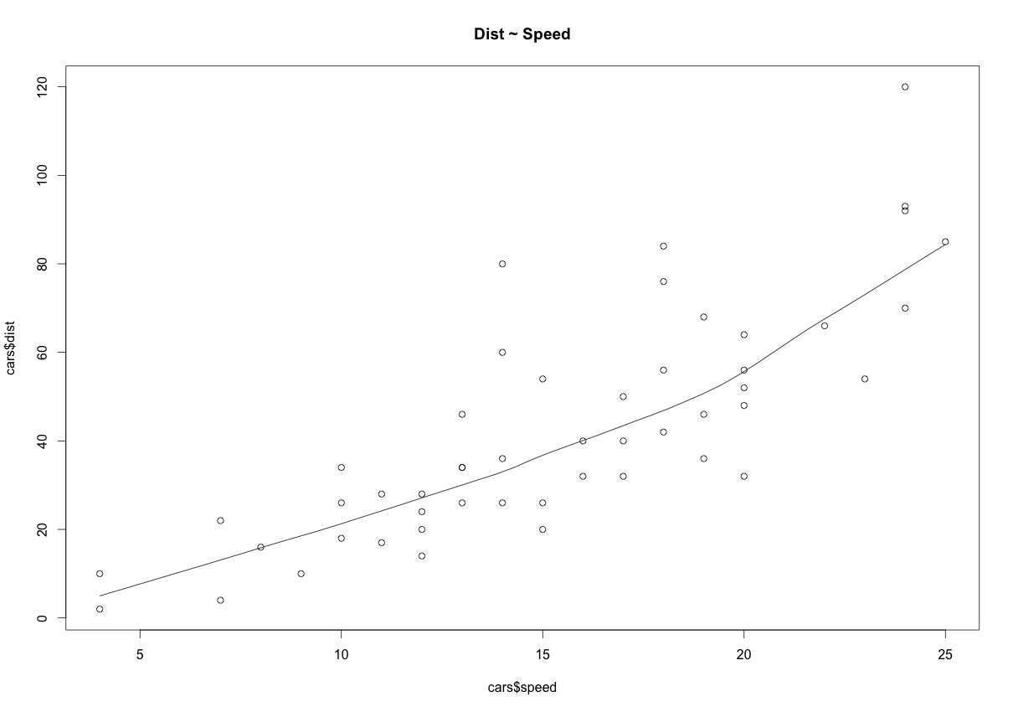
Checking for Linear trend
scatter.smooth(x=cars$speed, y=cars$dist, main="Dist ~ Speed")
# scatterplot with smoothed line can show trend in “cloud” of points
http://r-statistics.co/Assumptions-of-Linear-Regression.html
ISSU2028 Data Science Dr Phil Lewis

Slide 19
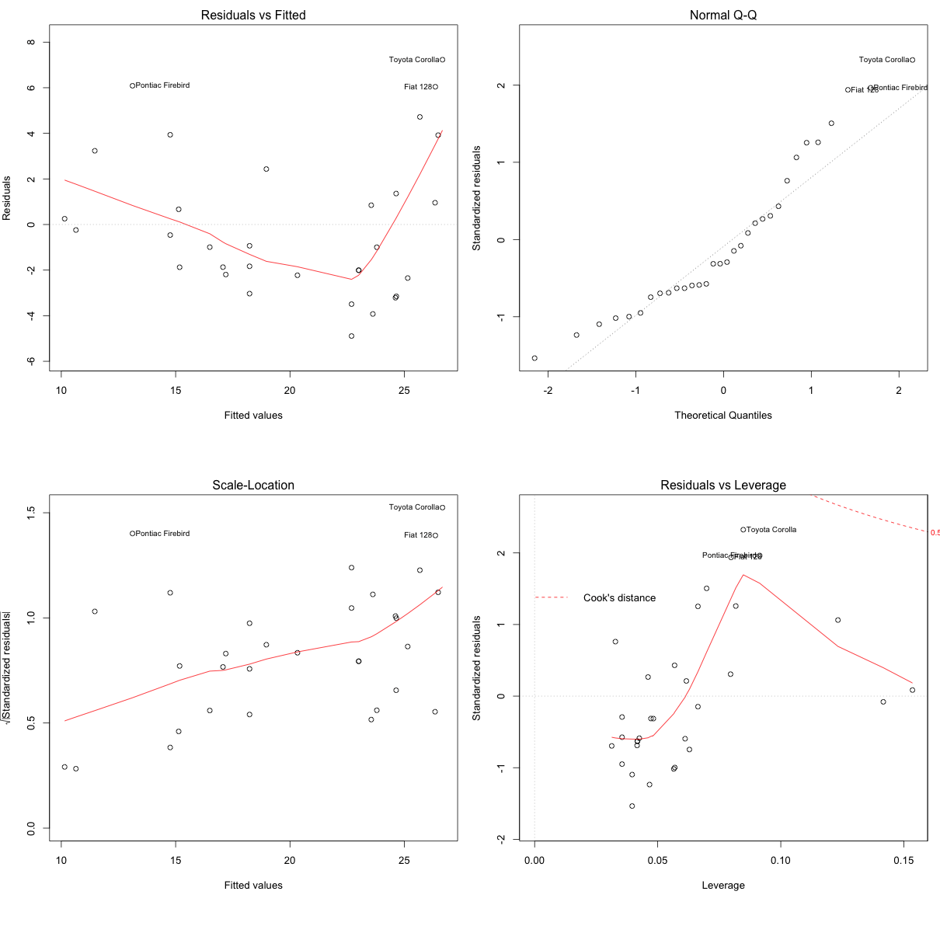
Viewing problems by examining residuals
Viewing problems by plotting the residuals
par(mfrow=c(2,2)) # set 2 rows and 2 column plot layout
myfit <- lm(mpg ~ disp, data=mtcars) # linear model
plot(myfit)
Labels indicate potentially problematic rows
2. Shows Q-Q plot to see if residuals are distributed consistent with normal (on diagonal)
1. Shows trend in residuals
3. Shows trend in residual variance.
4. Shows trend in residuals and leverage (distortions to fit by outliers).
ISSU2028 Data Science Dr Phil Lewis

Slide 20
Viewing problems by examining residuals
Viewing problems by plotting the residuals
1. Shows trend in residuals
To manually retrieve residuals on each point:
residuals(model1)
https://data.library.virginia.edu/diagnostic-plots/
ISSU2028 Data Science Dr Phil Lewis

Slide 21
Viewing problems by examining residuals
Viewing problems by plotting the residuals
2. Shows Q-Q plot to see if residuals are distributed consistent with normal (on diagonal)
https://data.library.virginia.edu/diagnostic-plots/
ISSU2028 Data Science Dr Phil Lewis

Slide 22
Viewing problems by examining residuals
Viewing problems by plotting the residuals
3. Shows trend in residual variance.
https://data.library.virginia.edu/diagnostic-plots/
ISSU2028 Data Science Dr Phil Lewis

Slide 23
Viewing problems by examining residuals
Viewing problems by plotting the residuals
4. Shows trend in residuals and leverage (distortions to fit by outliers).
Points with large “Cook’s distance” beyond indicated boundaries are distorting the fit. Examine and consider what to do…
https://data.library.virginia.edu/diagnostic-plots/
ISSU2028 Data Science Dr Phil Lewis

Slide 24
Viewing problems by examining residuals
Viewing problems by plotting the residuals
library("gvlma")
myfit <- lm(dist ~ speed, data=cars)
gvlma(myfit)
#=> Value p-value Decision
#=> Global Stat 15.801 0.003298 Assumptions NOT satisfied!
#=> Skewness 6.528 0.010621 Assumptions NOT satisfied!
#=> Kurtosis 1.661 0.197449 Assumptions acceptable.
#=> Link Function 2.329 0.126998 Assumptions acceptable.
#=> Heteroscedasticity 5.283 0.021530 Assumptions NOT satisfied!
Global Stat- Are the relationships between your X predictors and Y roughly linear?. Rejection of the null (p < .05) indicates a non-linear relationship between one or more of your X’s and Y
Skewness - Is your distribution skewed positively or negatively, necessitating a transformation to meet the assumption of normality? Rejection of the null (p < .05) indicates that you should likely transform your data.
Kurtosis- Is your distribution kurtotic (highly peaked or very shallowly peaked), necessitating a transformation to meet the assumption of normality? Rejection of the null (p < .05) indicates that you should likely transform your data.
Link Function- Is your dependent variable truly continuous, or categorical? Rejection of the null (p < .05) indicates that you should use an alternative form of the generalized linear model (e.g. logistic or binomial regression).
Heteroscedasticity- Is the variance of your model residuals constant across the range of X (assumption of homoscedastiity)? Rejection of the null (p < .05) indicates that your residuals are heteroscedastic, and thus non-constant across the range of X. Your model is better/worse at predicting for certain ranges of your X scales.
https://stackoverflow.com/questions/43252474/using-and-interpreting-output-from-gvlma
ISSU2028 Data Science Dr Phil Lewis

Slide 25
Examining for collinearity
Viewing problems by plotting the residuals
Collinearity – predictors that are highly correlated.
If two predictors are highly correlated we could used either to accurately fit predictor. This leads to an inflated error estimate on the coefficients of the correlated terms (variance inflation).
To see if this is a problem we use R function vif.
library(car)
myfit <- lm(mpg ~ ., data=mtcars)
vif(myfit)
# cyl disp hp drat wt qsec vs am gear carb
# 15.373833 21.620241 9.832037 3.374620 15.164887 7.527958 4.965873 4.648487 5.357452 7.908747
Check using the correlations (cor command can take a set of columns).
To fix: either remove one of correlated predictors or combine the correlated predictors (e.g. simple way would be to average them).
ISSU2028 Data Science Dr Phil Lewis

Slide 26
Regression Assumptions
Viewing problems by plotting the residuals
To work through exercises and see how to detect Heteroskadacity (and correct the fit for it)
http://uclspp.github.io/PUBLG100/seminar7.html
ISSU2028 Data Science Dr Phil Lewis

